Slide 1

#1 Introduction to Object-Oriented Programming in JavaScript

Slide 2

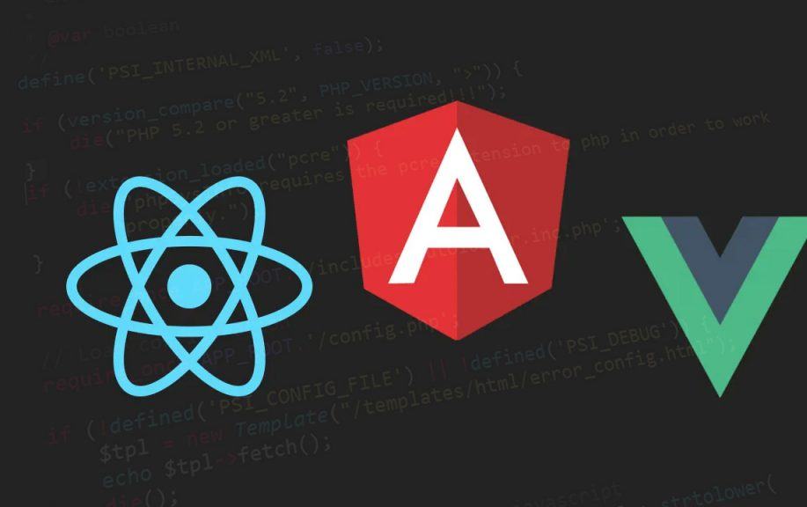
JavaScript is traditionally a prototype-based language, but it supports OOP concepts like encapsulation, inheritance, and polymorphism
Many modern JavaScript frameworks, such as React, Angular, and Vue, incorporate OOP principles within their component-based architecture and reactive programming features
We will explore how each framework or library uses OOP concepts:

Slide 3

#2 OOP in React

Slide 4

Components as Classes and Objects
Class-based components, especially before React hooks were introduced, were the primary method for creating components
In React, components can be built using JavaScript classes

Slide 5



JavaScript
class MyComponent extends React.Component { constructor(props) { super(props); this.state = { count: 0, }; } incrementCount() { this.setState({ count: this.state.count + 1 }); } render() { return ( <div> <p>{this.state.count}</p> <button onClick={() => this.incrementCount()}>Increment</button> </div> ); } }
Encapsulation: The state is encapsulated within the component, and only methods within the class can modify it.
Inheritance: MyComponent extends React.Component, which provides lifecycle methods like componentDidMount, shouldComponentUpdate, and more.

Slide 6

Polymorphism
React supports polymorphism by allowing different components to render based on different props, making the same component behave differently based on data

Slide 7
Challenges in React
With the introduction of hooks, React shifted from class-based to functional components, making it more functional-programming-focused
Hooks like useState and useEffect replace the traditional OOP-like class lifecycle methods
However, you can still use OOP concepts in React if you prefer class-based components, but it is becoming less common in newer projects​

Slide 8

#3 OOP in Angular
Angular is much more structured than React or Vue and is strongly built on OOP concepts due to its TypeScript foundation
Components and Services as Classes
Angular components are strictly class-based. Here is a typical Angular component:

Slide 9
TypeScript
import { Component } from '@angular/core'; @Component({ selector: 'app-my-component', templateUrl: './my-component.component.html', }) export class MyComponent { count: number = 0; incrementCount() { this.count++; } }
Encapsulation: Angular uses decorators like @Component, which encapsulate logic within the class
Inheritance: You can extend other classes or implement interfaces, thanks to TypeScript, allowing for strong OOP practices

Slide 10

TypeScript
class BaseComponent {​ logMessage() {​ console.log("Logging from BaseComponent");​ }​ }​ ​ class ChildComponent extends BaseComponent {​ customLog() {​ this.logMessage();​ }​ }​

Slide 11
TypeScript
@Injectable() export class DataService { getData() { return ["data1", "data2"]; } } @Component({ selector: 'app-root', template: '<h1>My App</h1>', }) export class AppComponent { constructor(private dataService: DataService) {} ngOnInit() { const data = this.dataService.getData(); }
}
Dependency
Injection
One of Angular’s strongest OOP patterns is Dependency Injection (DI). Angular services can be injected into components, promoting separation of concerns and code reuse.

Slide 12

Challenges in Angular
Angular’s strict adherence to OOP via TypeScript may make it harder to onboard developers who are not familiar with TypeScript or classical OOP patterns. It enforces strong typing, which may be a learning curve for some JavaScript developers.
Encapsulation and Abstraction: Services encapsulate data-fetching logic and abstract it from the component.

Slide 13

#4 OOP in Vue
Vue, like React, is flexible in terms of allowing both functional programming and OOP practices
Vue's components can either be written using JavaScript objects or TypeScript classes
ThePhoto by PhotoAuthor is licensed under CCYYSA.

Slide 14

Object-Oriented Components
Traditionally, Vue components are built with options API where the component is essentially an object
However, using the Vue Class Component library, you can write components in a more OOP style with classes

Slide 15
JavaScript
export default { ​ data() { ​ return { ​ count: 0 ​ }; ​ }, ​ methods: { ​ incrementCount() { ​ this.count++; ​ } ​ } ​ }; ​

Slide 16

TypeScript
export default { ​ data() { ​ return { ​ count: 0 ​ }; ​ }, ​ methods: { ​ incrementCount() { ​ this.count++; ​ } ​ } ​ }; ​

Slide 17
Encapsulation & Reusability
const myMixin = { data() { return { sharedData: "I am shared" }; }, methods: { sharedMethod() { console.log(this.sharedData); } } }; export default { mixins: [myMixin], mounted() { this.sharedMethod(); // Can access sharedMethod from mixin } };
JavaScript
Vue supports mixins and extends to allow reusing code and encapsulating logic, similar to inheritance and polymorphism in OOP

Slide 18
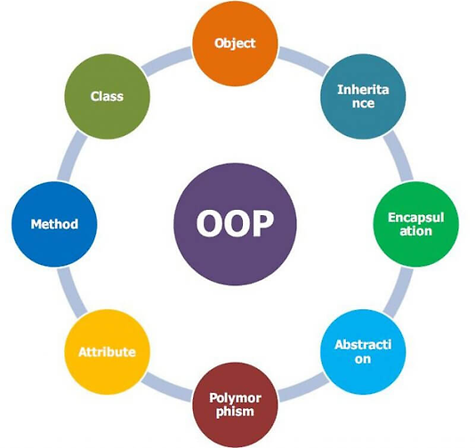
Vue 3 introduced the Composition API, which is closer to functional programming
Still, OOP concepts can be applied within this API, but it promotes separating logic into composable functions rather than classes or objects
ThePhoto by PhotoAuthor is licensed under CCYYSA.

Slide 19
Challenges in Vue
Though Vue’s class-based components are a popular choice for TypeScript users, Vue’s flexibility sometimes blurs the lines between functional and object-oriented styles
Developers may end up mixing paradigms, which can lead to less structured code

Slide 20

#5 Conclusion: Common OOP Patterns Across Frameworks
Encapsulation: Encapsulation of logic inside components is common across React, Angular, and Vue
Inheritance and Polymorphism: React and Vue allow inheritance , but Angular provides the most structured way to handle inheritance and polymorphism due to its TypeScript integration
Abstraction: Angular excels with abstraction via services and dependency injection, while Vue and React provide flexibility with hooks or mixins

